Slide 1

8th Grade Math: Pre-Algebra
Unit 4, Lesson 4 Evaluating Numerical Expressions with Integer Exponents – Part 1 Volume 1, pg. 139

Slide 2


Benchmark
MA.8.NSO.1.3
Extend previous understanding of the Laws of Exponents to include integer exponents. Apply the Laws of Exponents to evaluate numerical expressions and generate equivalent numerical expressions, limited to integer exponents and rational number bases, with procedural fluency.
volume 1, pg. 139

Slide 3
Integrated Mathematical Thinking and Reasoning Standards
MA.K12.MTR.3.1 Complete tasks with mathematical fluency.
MA.K12.MTR.4.1 Engage in discussions that reflect on the mathematical thinking of self and others.
volume 1, pg. 139

Slide 4

Learning Target
I can evaluate a numerical expression using the laws of exponents.
volume 1, pg. 139

Slide 5

Warm-Up
volume 1, pg. 139

Slide 6
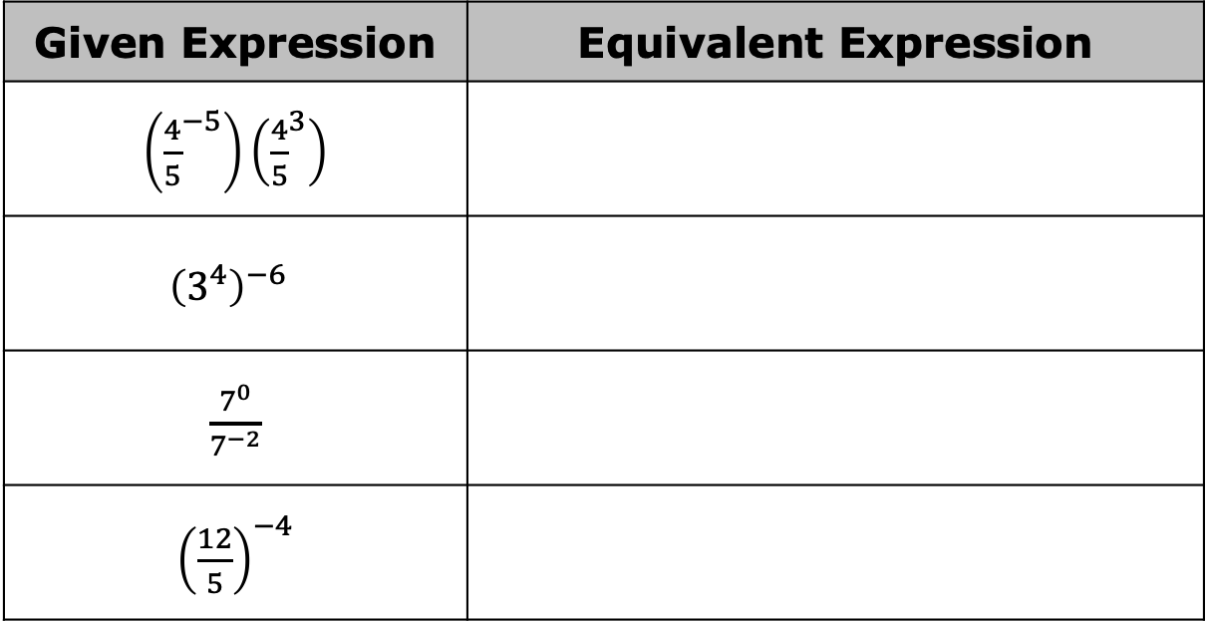
4.4.1 Warm-Up: Bell Work
For each expression, apply one or more exponent laws to write an equivalent expression with a rational base and positive exponent.
Given Expression | Equivalent Expression
$\left({\frac{4}{5}}^{−5}\right)\left({\frac{4}{5}}^{3}\right)$
$${\left(3^{4}\right)}^{−6}$$
$\frac{7^{0}}{7^{−2}}$
${\left(\frac{12}{5}\right)}^{−4}$
volume 1, pg. 139

Slide 7

Guided Instruction
volume 1, pg. 140

Slide 8

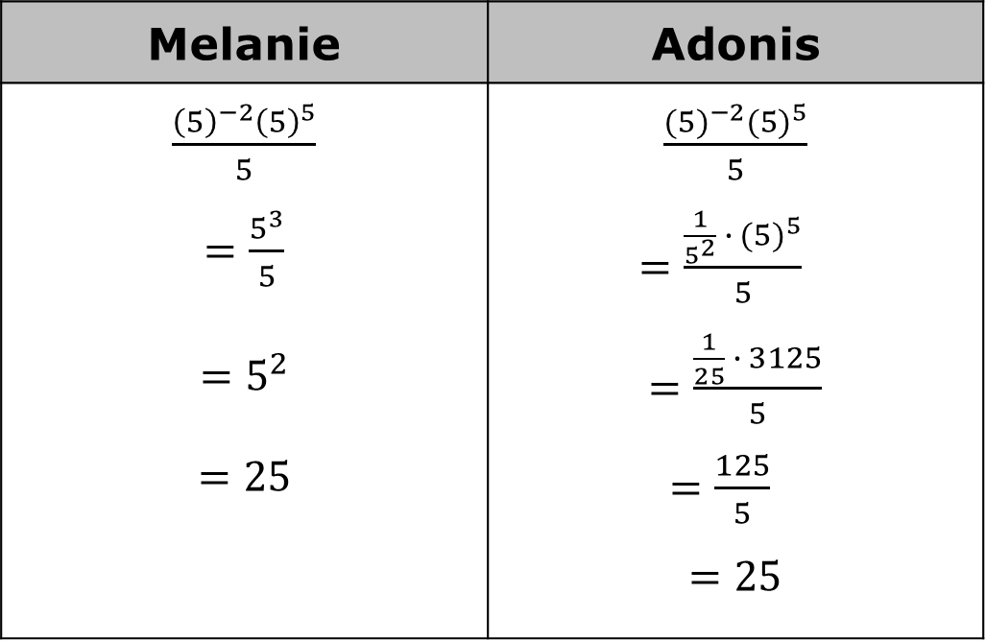
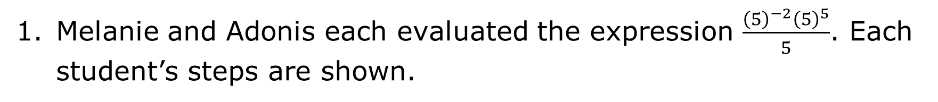
4.4.2 Guided Instruction: Using the Laws of Exponents to Evaluate Expressions
Melanie and Adonis each evaluated the expression $\frac{{\left(5\right)}^{−2}{\left(5\right)}^{5}}{5}$. Each student’s steps are shown.
Melanie | Adonis
$\frac{{\left(5\right)}^{−2}{\left(5\right)}^{5}}{5}$ $=\frac{5^{3}}{5}$ $$=5^{2}$$ $$=25$$ | $\frac{{(5)}^{−2}{(5)}^{5}}{5}$ $=\frac{\frac{1}{5^{2}} ∙ {(5)}^{5}}{5}$ $=\frac{\frac{1}{25} ∙ 3125}{5}$ $=\frac{125}{5}$ $$=25$$
volume 1, pg. 140

Slide 9
Discuss with your partner how Melanie’s steps and Adonis’ steps are similar and different from each other. Then, summarize your discussion in the table.
Similarities | Differences
volume 1, pg. 140

Slide 10

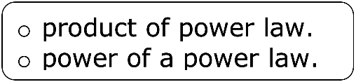
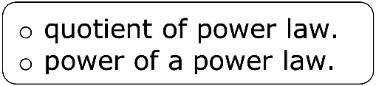

Complete the steps to evaluate the expression $\frac{{\left(6^{2}\right)}^{−3}}{6^{−5}}$ by completing the description of each step and writing the resulting equivalent expression on the line that follows.
Apply ____________
Apply ____________
Evaluate. ____________
When evaluating exponential expressions, it is helpful to apply the laws of exponents before evaluating.
volume 1, pg. 140

Slide 11
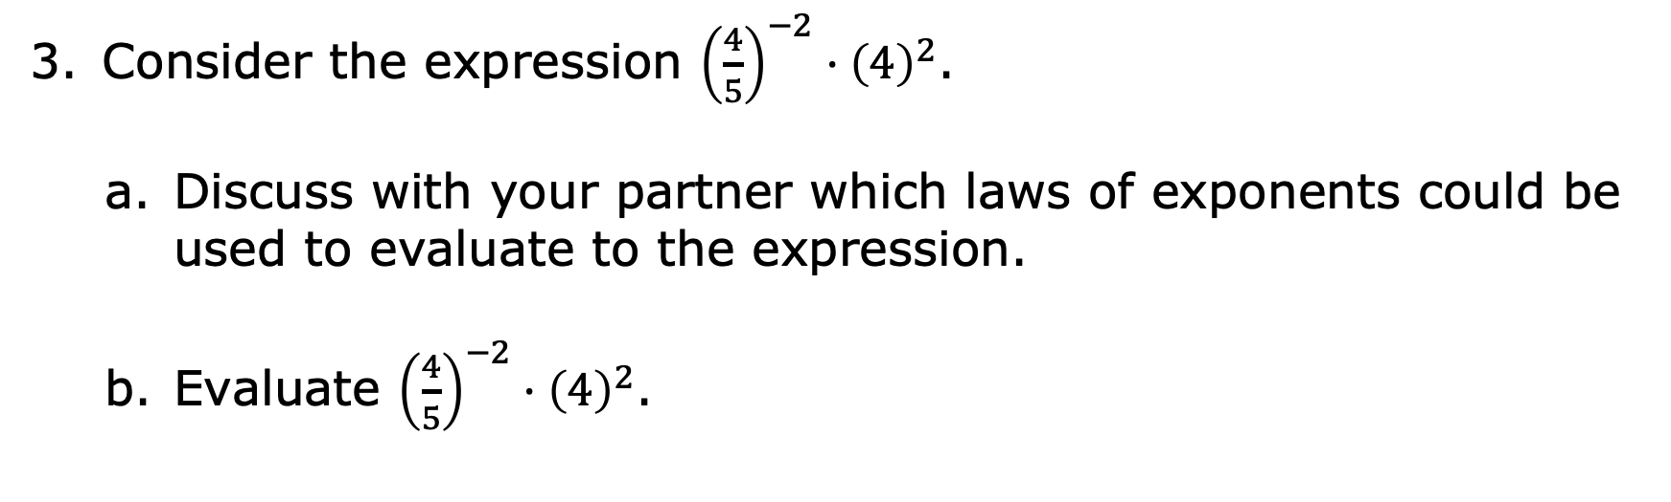
Consider the expression ${\left(\frac{4}{5}\right)}^{−2}·{\left(4\right)}^{2}$.
Discuss with your partner which laws of exponents could be used to evaluate to the expression.
Evaluate ${\left(\frac{4}{5}\right)}^{−2}·{\left(4\right)}^{2}$.
volume 1, pg. 140

Slide 12

Try It
volume 1, pg. 141

Slide 13
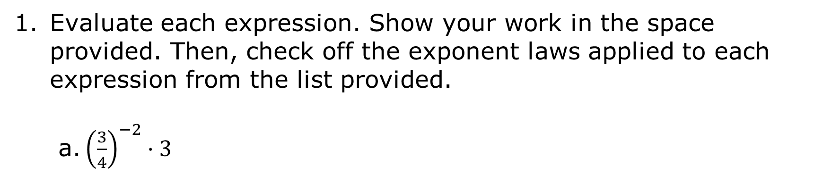
4.4.3 Try It: Evaluating Expressions
Evaluate each expression. Show your work in the space provided. Then, check off the exponent laws applied to each expression from the list provided.
a. ${\left(\frac{3}{4}\right)}^{−2}·3$
Exponent Laws Applied
identity exponent negative exponent power of a power power of a product power of a quotient product of powers quotient of powers zero exponent
volume 1, pg. 141

Slide 14
b. $\frac{{\left(−7\right)}^{5}}{{\left(−7\right)}^{0}·{\left(−7\right)}^{2}}$
Exponent Laws Applied
identity exponent negative exponent power of a power power of a product power of a quotient product of powers quotient of powers zero exponent
volume 1, pg. 141

Slide 15

Activity
volume 1, pg. 141

Slide 16
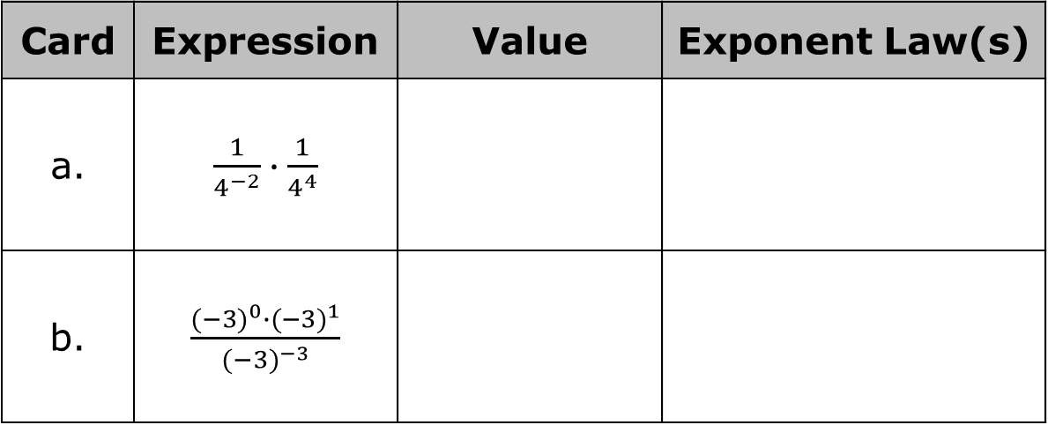
4.4.4 Activity: Card Sort
Work with your partner to match each expression card with the exponent law and value cards. The exponent law cards indicate which laws of exponents can be applied to the expression before evaluating and the value cards indicate the value of the expression. Write the letter or number associated with the matching cards in the table.
Card | Expression | Value | Exponent Law(s)
a. | $\frac{1}{4^{−2}}∙\frac{1}{4^{4}}$
b. | $\frac{{(−3)}^{0}∙{(−3)}^{1}}{{(−3)}^{−3}}$
volume 1, pg. 141

Slide 17
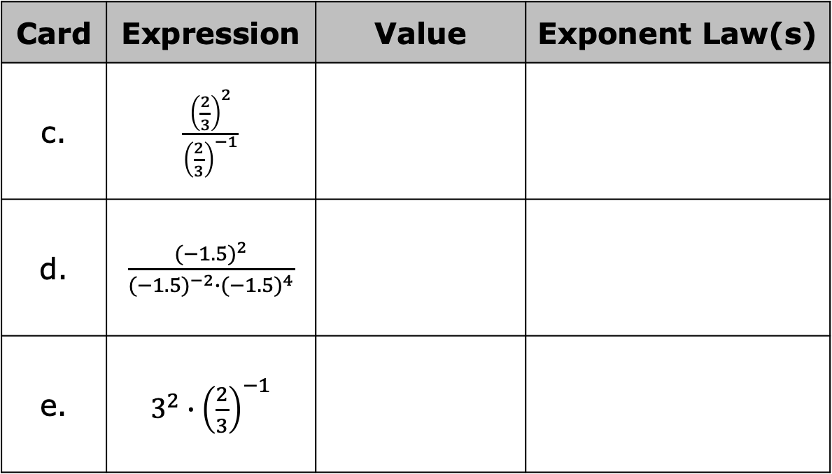
Card | Expression | Value | Exponent Law(s)
c. | $\frac{{\left(\frac{2}{3}\right)}^{2}}{{\left(\frac{2}{3}\right)}^{−1}}$
d. | $\frac{{(−1.5)}^{2}}{{(−1.5)}^{−2}∙{(−1.5)}^{4}}$
e. | $3^{2}∙{\left(\frac{2}{3}\right)}^{−1}$
volume 1, pg. 141

Slide 18

Your Turn
volume 1, pg. 142

Slide 19
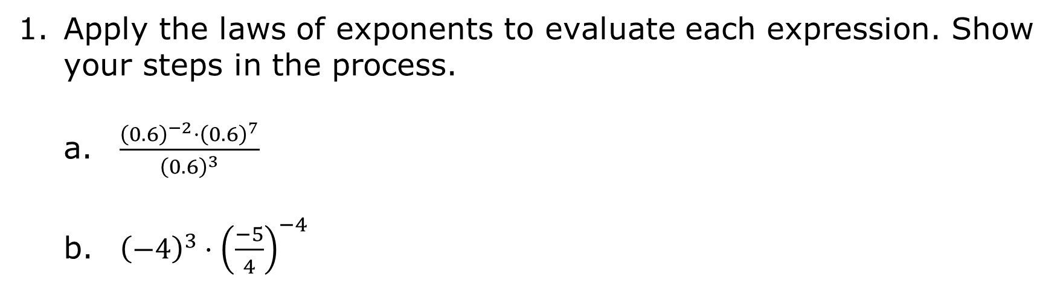
4.4.5 Your Turn!
Apply the laws of exponents to evaluate each expression. Show your steps in the process.
$\frac{{\left(0.6\right)}^{−2}·{\left(0.6\right)}^{7}}{{\left(0.6\right)}^{3}}$
${\left(−4\right)}^{3}·{\left(\frac{−5}{4}\right)}^{−4}$
volume 1, pg. 142

Slide 20
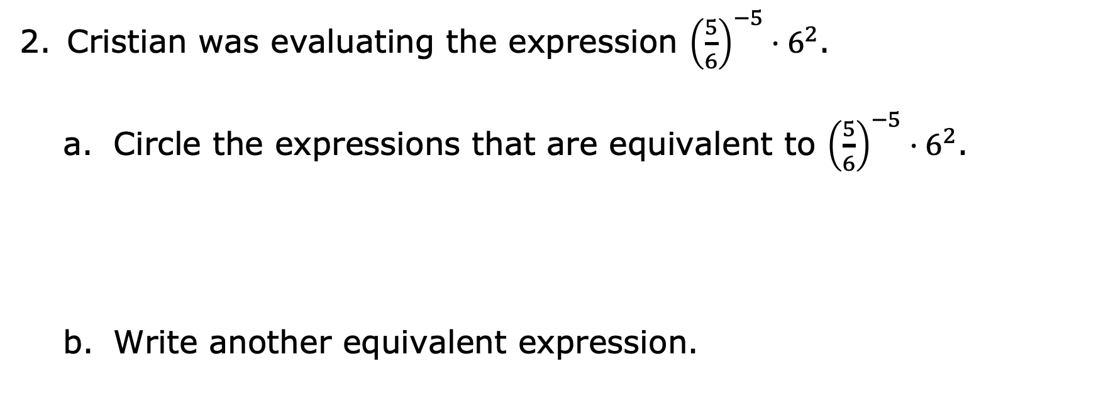
Cristian was evaluating the expression ${\left(\frac{5}{6}\right)}^{−5}·6^{2}$.
Circle the expressions that are equivalent to ${\left(\frac{5}{6}\right)}^{−5}·6^{2}$.
Write another equivalent expression.
$\frac{5^{−5}}{6^{−5}}∙6^{2}$ | $5^{−5}∙\frac{6^{2}}{6}$ | $\frac{5^{−6}}{6^{−6}}∙6^{2}$ | ${\left(\frac{6}{5}\right)}^{5}∙6^{2}$
volume 1, pg. 142

Slide 21

Wrap-Up
volume 1, pg. 142

Slide 22
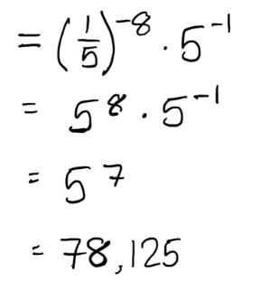
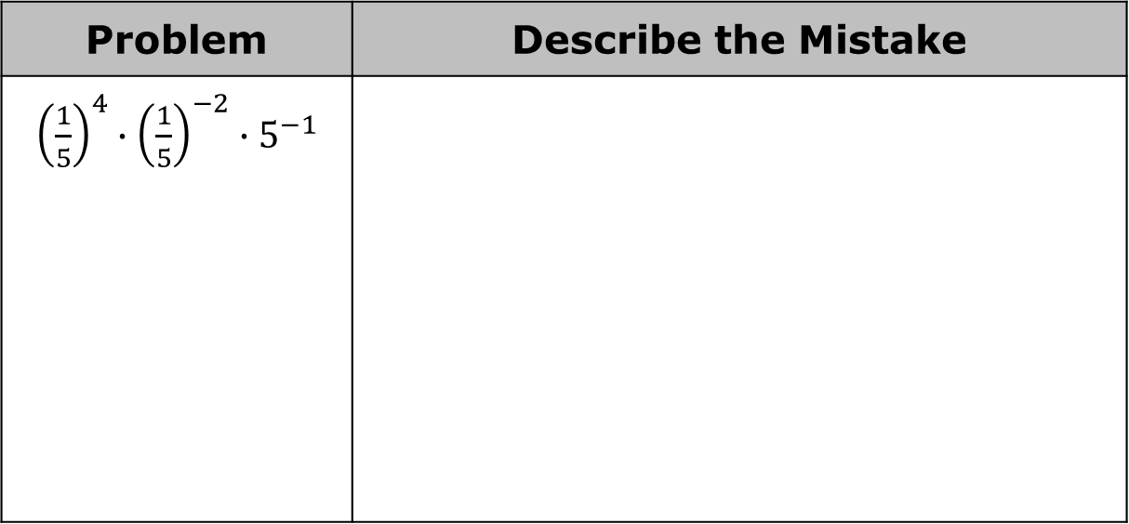
4.4.6 Wrap-Up: Error Analysis
Two students each evaluated an expression. Their work is shown in the table. Each student made a mistake. Circle the step where each student made an error and describe the mistake they made.
Problem | Describe the Mistake
${\left(\frac{1}{5}\right)}^{4}∙{\left(\frac{1}{5}\right)}^{−2}∙5^{−1}$
volume 1, pg. 142

Slide 23
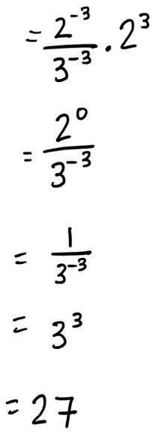
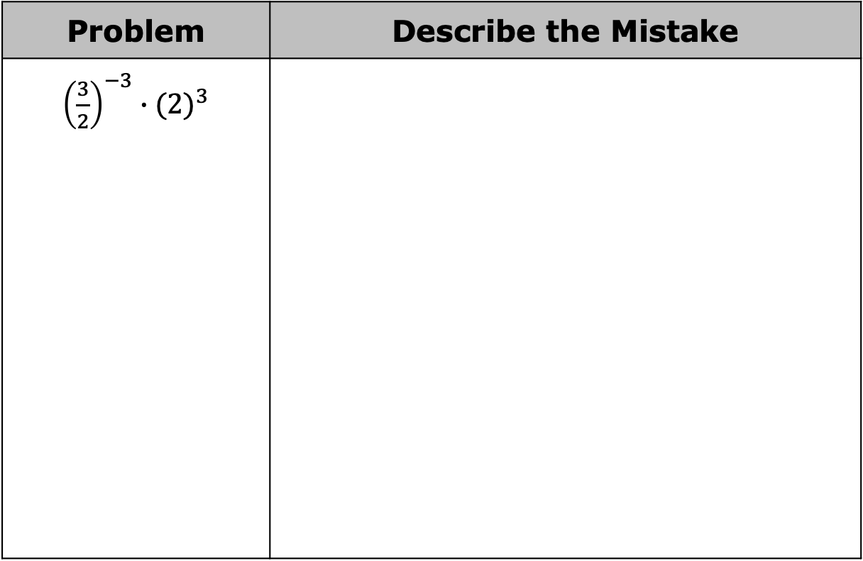
Problem | Describe the Mistake
${\left(\frac{3}{2}\right)}^{−3}∙{(2)}^{3}$
volume 1, pg. 142

